Slide 1

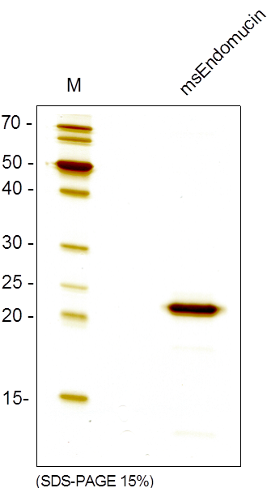
ReliaTech GmbH
Recombinant mouse ESAM
(Cat #S01-M64)
Fig. 1: SDS-PAGE analysis of recombinant mouse Endomucin derived from E. coli. Sample was loaded in 15% SDS-polyacrylamide gel under reducing conditions and stained with Coomassie blue.
http://www.reliatech.de / orders@reliatech.de

